Slide 1
EAGLE Pride
B.E.S.T. Academy at
The Thomas W. Dortch Jr. Institute
Robert Williams, Principal

Slide 2
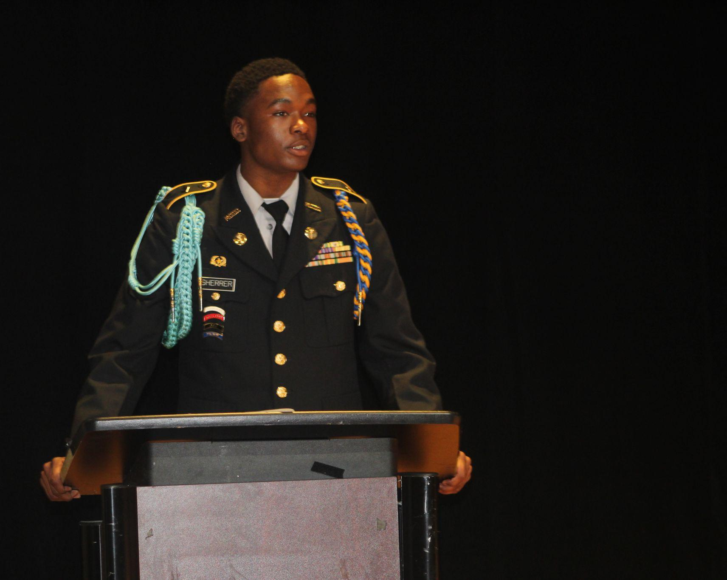
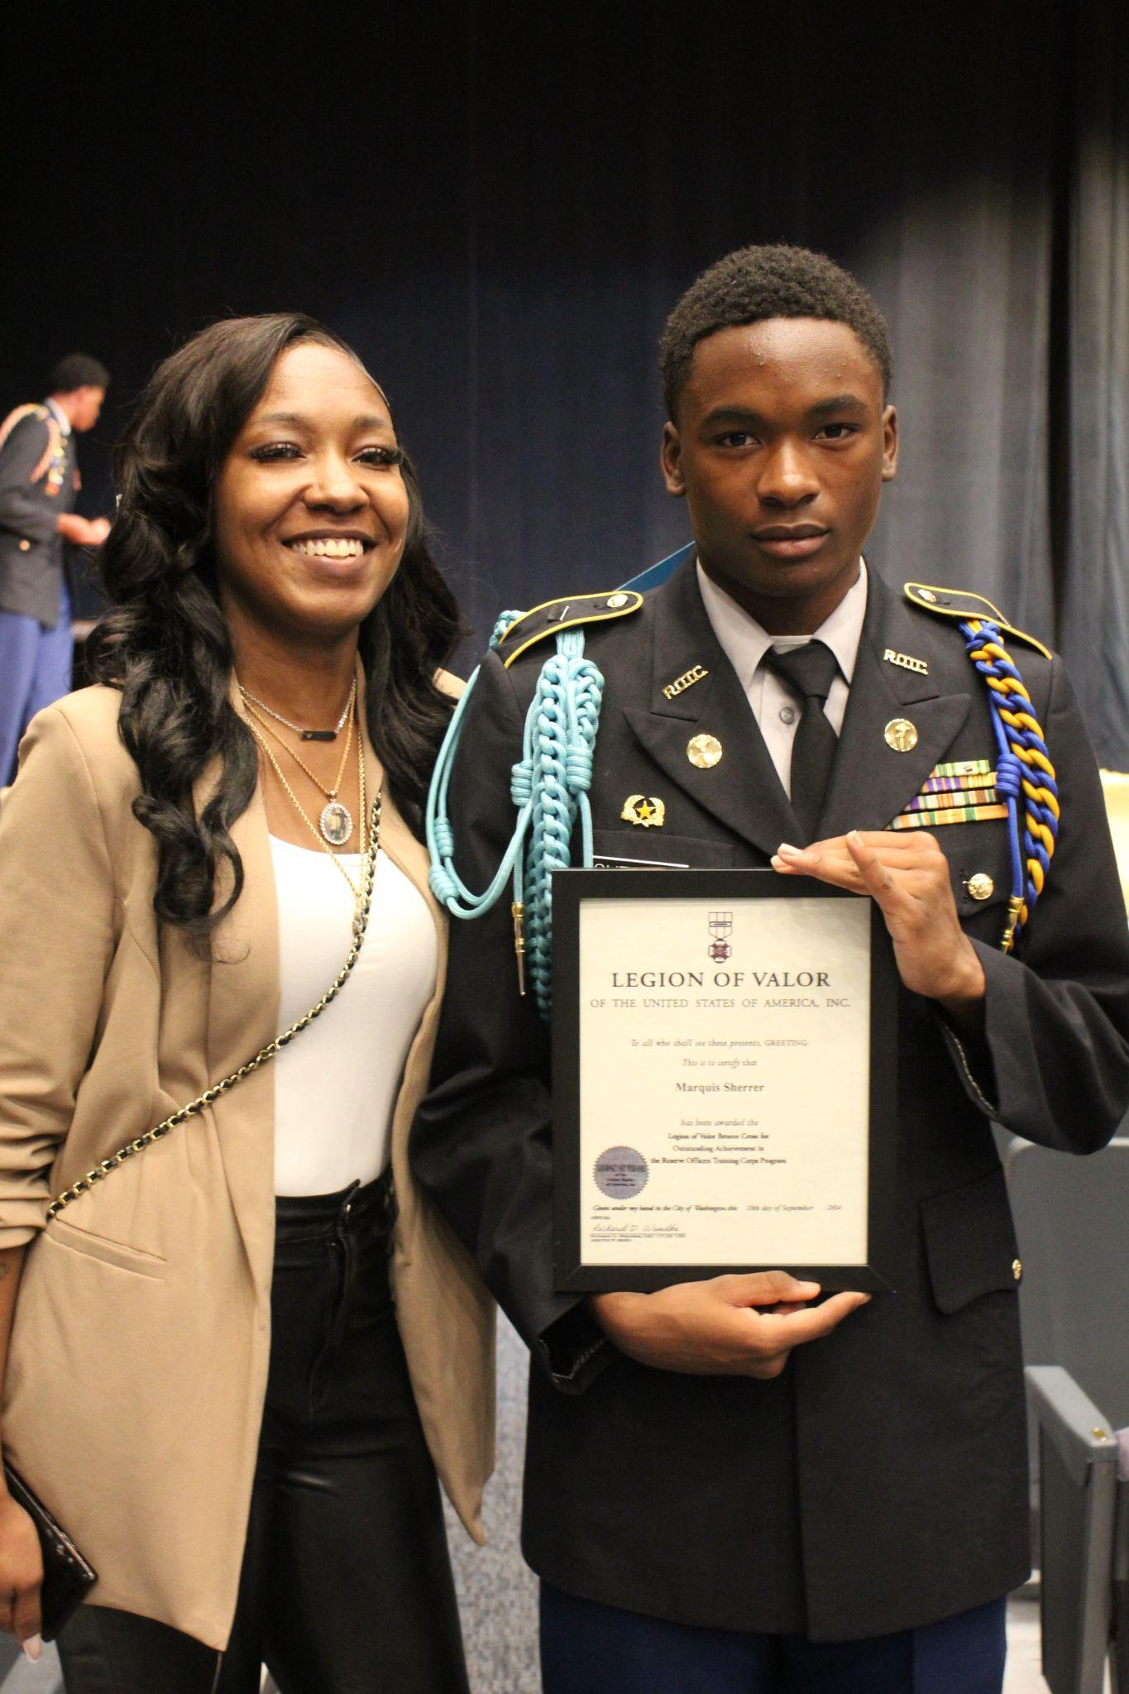
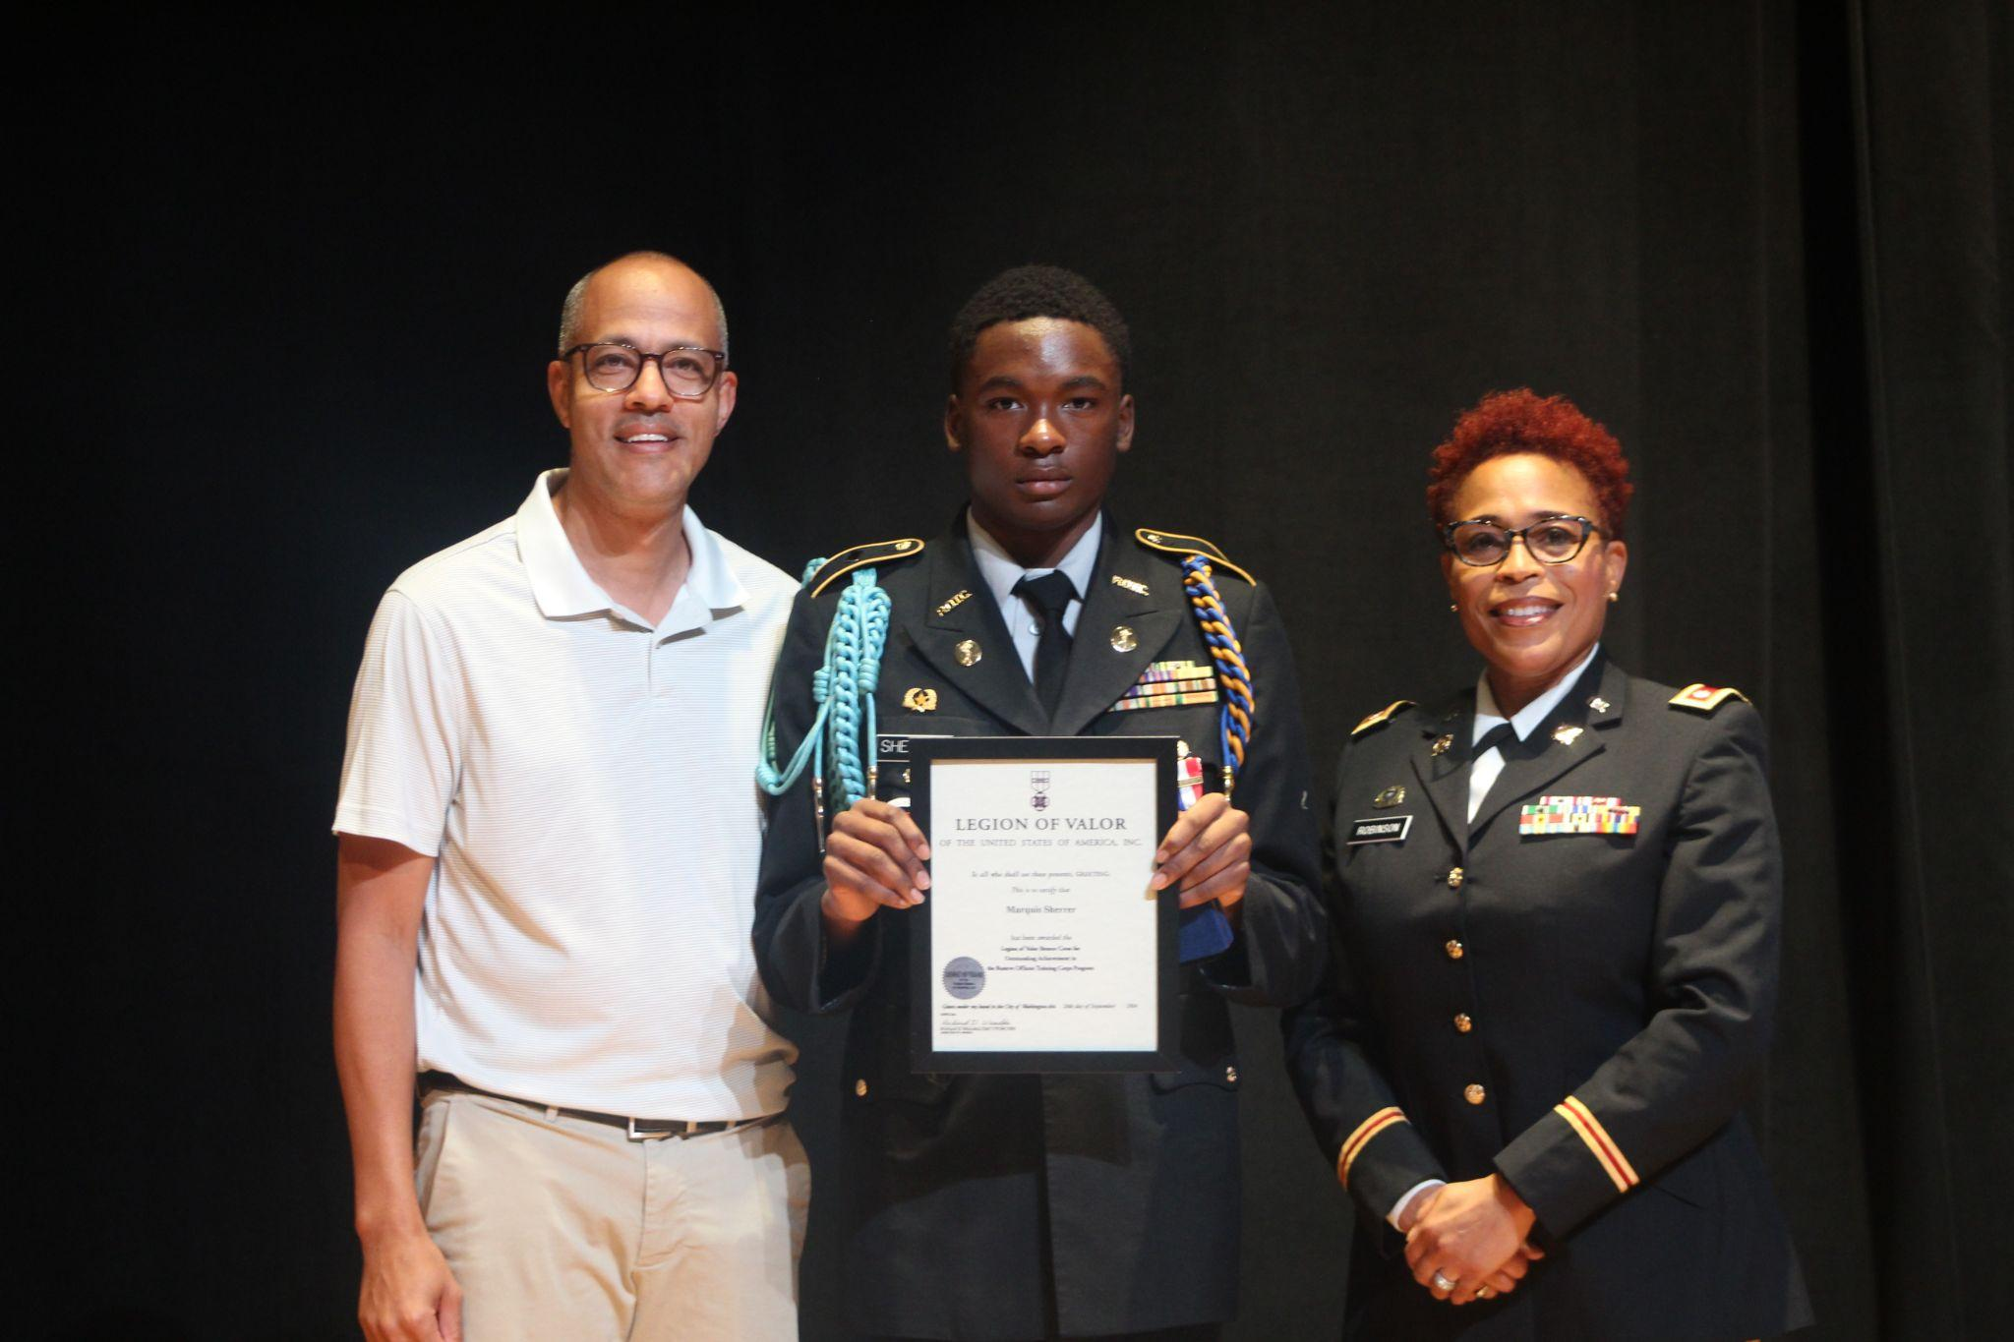
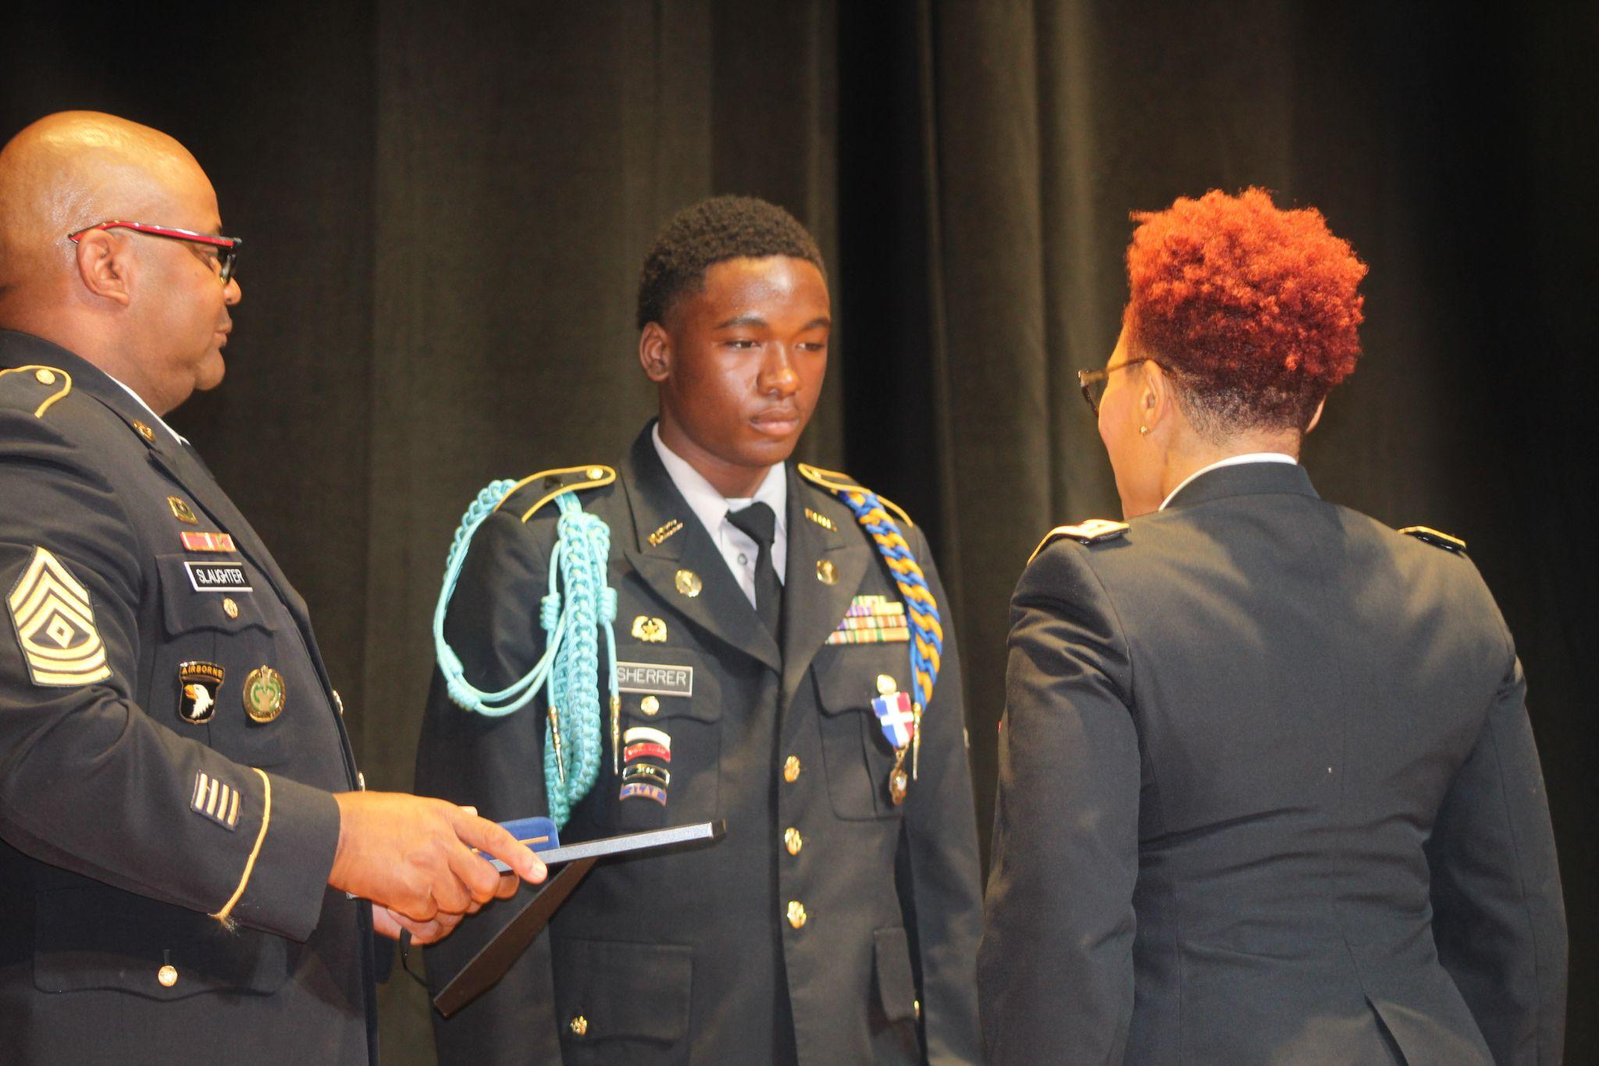
JROTC Cadet Marquis Sherrer Receives Prestigious
Legion of Valor Award of 2024
JROTC Cadet Marquis Sherrer has been honored with the prestigious Legion of Valor Award for 2024. This remarkable achievement sets him apart as the only cadet in Georgia to receive this esteemed recognition.
This recognition highlights not only Sherrer's dedication and hard work within the JROTC program, but also his exemplary leadership skills and commitment to excellence.
Marquis Sherrer, Legion of Valor Awardee for 2024
Marquis Sherrer, with his mother Ms. Wykelia Sherrer
Principal Williams, Cadet Sherrer and LTC. Robinson
!SGT. Slaughter, Cadet Sherrer and LTC. Robinson

Slide 3
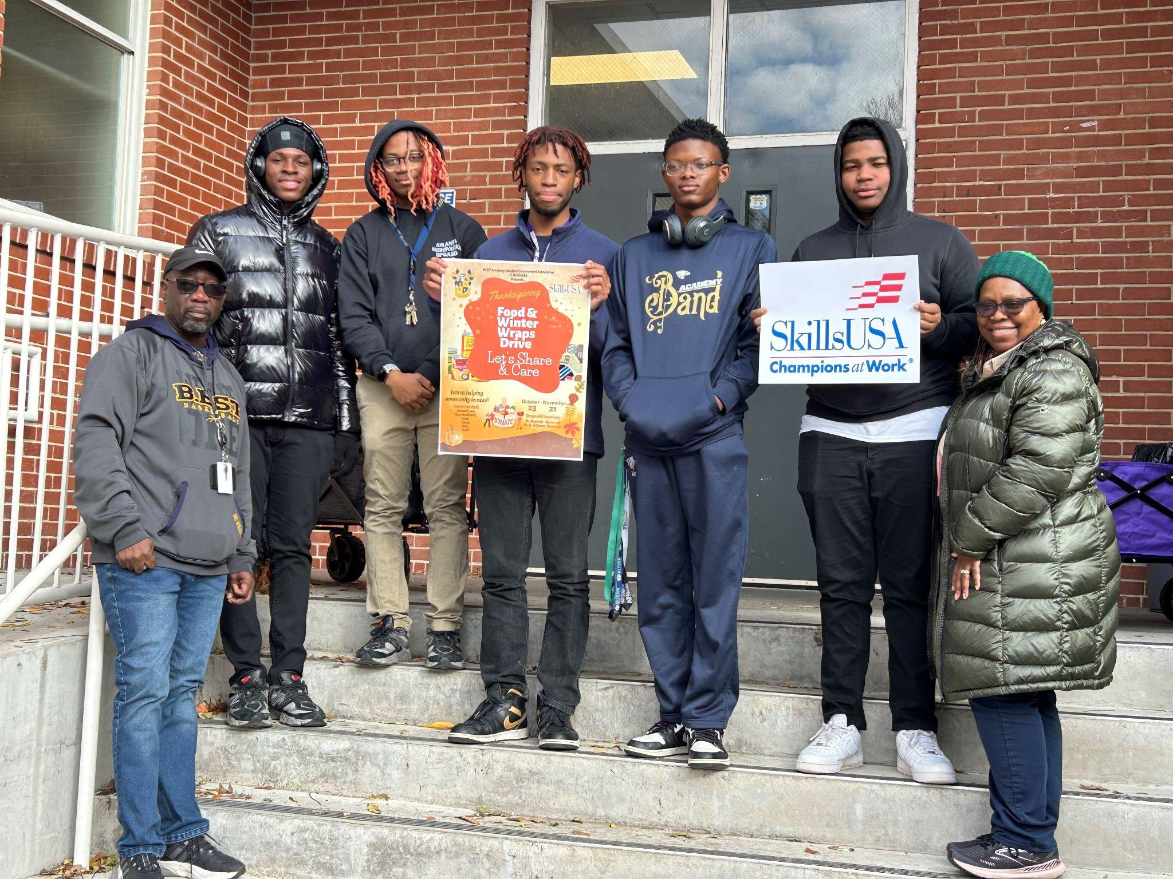
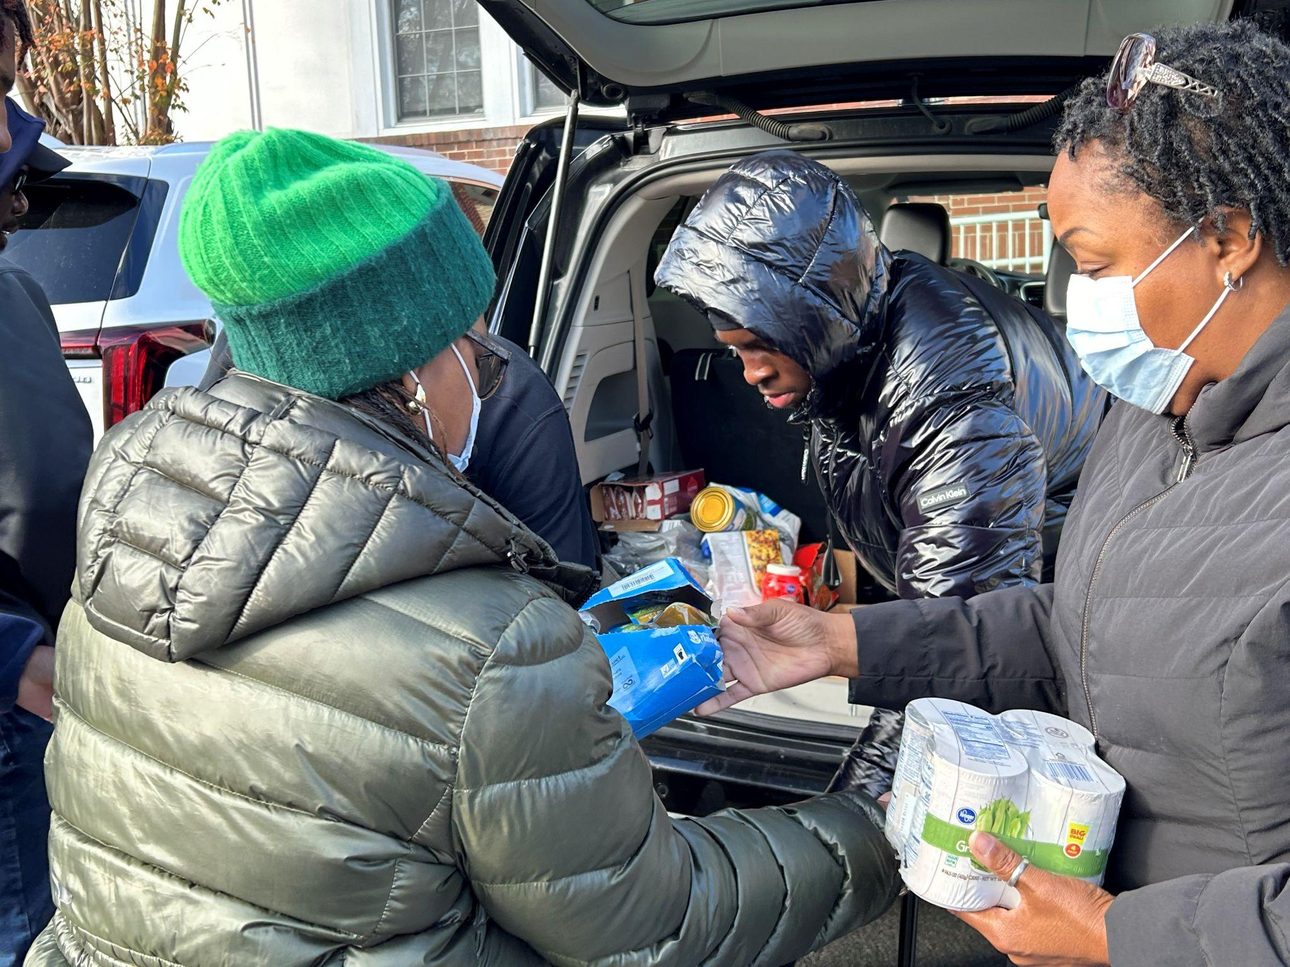
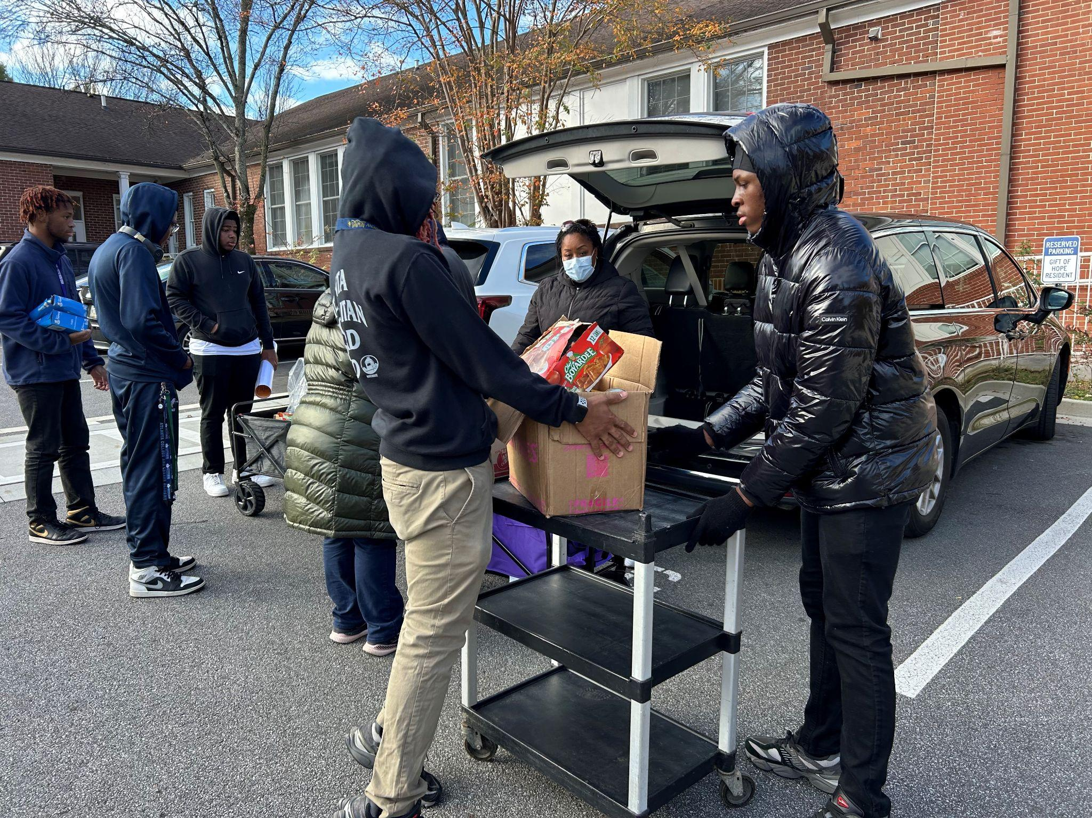
SGA and SkillsUSA
Thanksgiving Food Drive for Local Shelter
The Student Government Association and SkillsUSA unite for a Thanksgiving food drive benefiting a local shelter, offering crucial support to young people facing homelessness and survivors of trafficking. This event was sponsored by Dr. J. Reynolds and Dr. B. Williams.
SGA/SkillsUSA members load cart for distribution of donated items
Dr. Reynolds and Mrs. Dixon assisting SkillsUSA member Jaylen Kinsey with loading food donations
Left to right: Dr. B. Williams, Jaylen Kinsey, Aiden Goforth, Marcus Daniels, Marcel Copeland, Ijaaz Muhammad, and Dr. J. Reynolds participating in the Thanksgiving food drive for a local shelter.

Slide 4
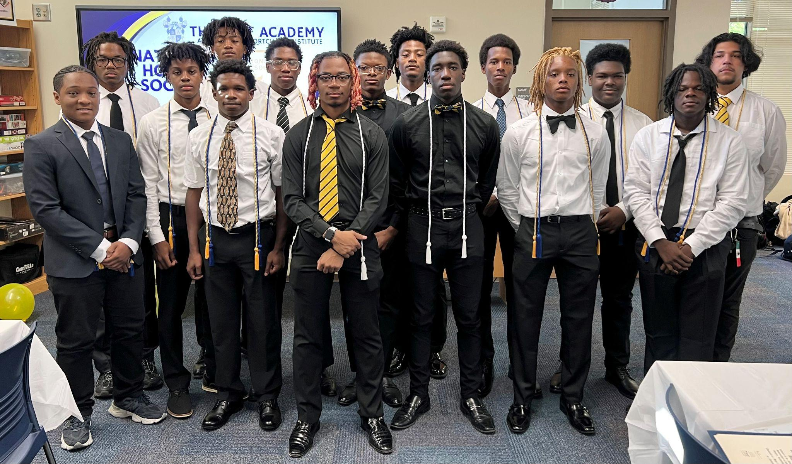
National Honor Society Induction
Cato, Irvin
Hajdasz, Daniel
Johnson, John
Light, Mahdi
Majette, Mariyo
Mickell, Jacob
Mickell, Joshua
Milsap, Jamir
Scott, Brandon
On December 13th, 11 new members were inducted into Best Academy's National Honor Society (NHS). The ceremony featured a keynote speech by Mr. Quinton Fields, with Mrs. Jamie Holt, NHS club sponsor, in attendance. Parents and relatives gathered to celebrate this special occasion.
Left to right: Mykel Smith Nathaniel Tuck, Mahdi Light, Jamir Milsap, Jacob Mickell, Mariyo Majette, (returning members in black: Aiden Goforth, Marcel Copeland, and Isaac Brown) Joshua Mickell, Daniel Hajdasz, John Johnson, Brandon Smith and Irvin Cato. Kevin Vallejo-Lara (returning member)

